Slide 1
Non-Dominated Adaptive-Restart Genetic Algorithm Optimization of Tractive Induction Motor Rotor Bar Considering Dynamic Operation Through Center of Gravity Method
Presented By: | Tim Stachl
 | M.A.Sc. Candidate
Supervisor: | Dr. Narayan C. Kar
Final Oral Defense Date: | May 19, 2022
Final Oral Defense Time: | 12:00 pm

Slide 2
Outline
I. |  | Research Objectives
II. |  | Literature Review
III. |  | Knowledge Gap and Novelty
IV. |  | Research Methodology
V. |  | Optimization Results
VI. |  | Conclusions
VII. |  | Future Research
VIII. |  | Publications to Date
IX. |  | Comments & Questions

Slide 3
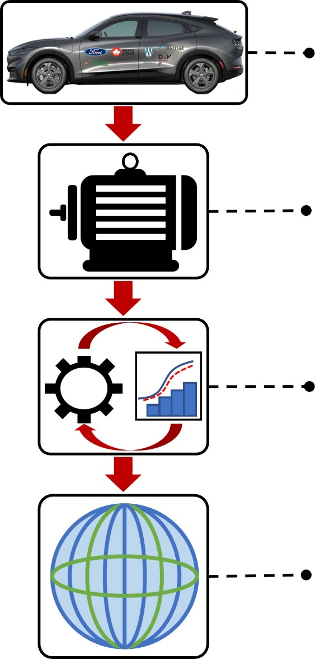
Research Objectives
Vehicle Level Objective:
Increase commercial EV range and tractive performance through design optimization of an electric motor improving operating efficiency by 1% and torque density by 3%.
Motor Level Objective:
Optimize rotor bar design for maximized torque and minimized losses resulting in a tractive IM with 3% higher output torque and 3% lower total losses for commercial EVs.
Algorithm Level Objective:
Develop robust non-dominated, multi-objective optimization algorithm considering dynamic operating range of tractive IMs capable of low run times and high solution quality.
Global Objective:
Develop and implement a novel, multi-objective algorithm to optimize rotor bar geometry considering dynamic operation resulting in high performance tractive IM improving commercial EVs.

Slide 4
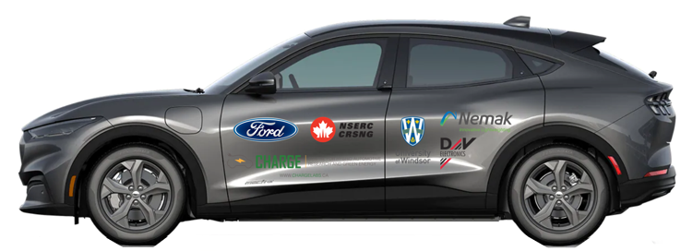
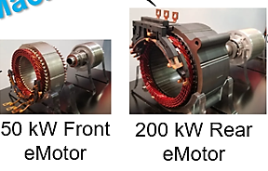
Current Electric Vehicles
Table 1.1 Comparison Between 2022 Electric Vehicles [1]–[3]
Vehicle Specifications | Audi e-tron | BMW iX3 | Ford Mustang Mach-E | Hyundai Ioniq 5 | Tesla Model Y
Drive Configuration | Dual Motor AWD | Single Motor RWD | Dual Motor AWD | Dual Motor AWD | Dual Motor AWD
Motor Type (F=front, R=Rear) | F: IM R: IM | PMSM | F: PMSM R: PMSM | F: PMSM R: PMSM | F: IM R: PMSM
Average Range (Mild Temp.) | 410 km | 440 km | 475 km | 425 km | 505 km
Acceleration (0 to 100 km/h) | 5.7 s | 6.8 s | 5.8 s | 5.2 s | 5 s
Top Speed | 200 km/h | 180 km/h | 180 km/h | 185 km/h | 217 km/h
Peak Torque | 664 Nm | 400 Nm | 580 Nm | 605 Nm | 493 Nm
Peak Power | 300 kW | 210 kW | 258 kW | 225 kW | 324 kW
Fig. 1. 2021 CHARGE Lab Mustang Mach-e AWD.
200kW Rear EM
50kW Front EM
Fig. 2. Front and rear PMSMs driving the Mustang Mach-e.
Global EV markets continue rapid expansion requiring improved technologies to increase EV range and tractive performance while maintaining competitive cost and weight margins.

Slide 5
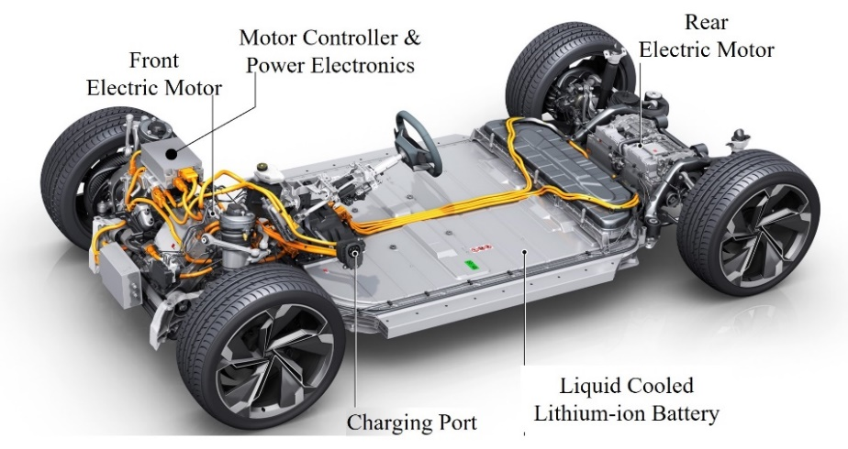
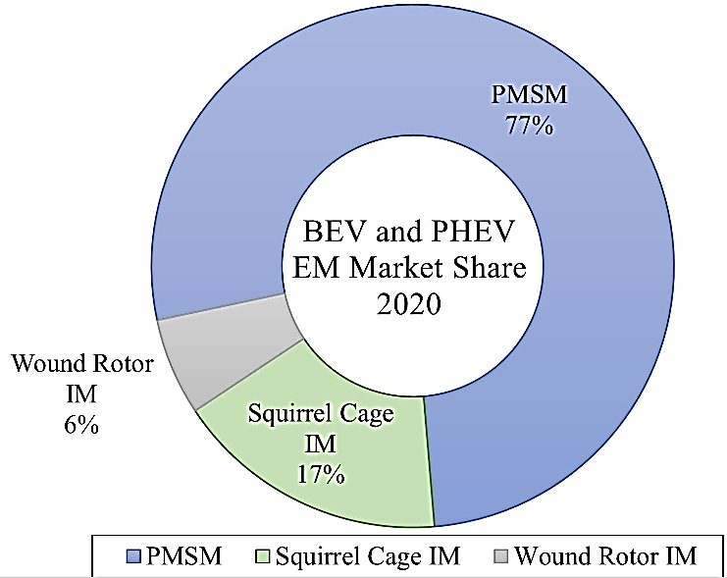
Tractive Electric Motors
Table 2. Advantages and Disadvantages of IMs and PMSMs [4], [5]
PMSM | Advantage | High torque and power density due to smaller size High efficiency and power factor Good head dissipation due to no rotor losses
 | Disadvantage | High material cost and lower efficiencies at high speeds Control is difficult especially in flux weakening High temperature demagnetization High back EMF during fault
IM | Advantage | Robust design and low material costs High peak torque, overload capability Relatively simple control methods Well established manufacturing process
 | Disadvantage | Demanding design process Lower efficiency due to rotor losses Lower power factor, torque and power densities
Fig. 3. Depicts the major components and relative configuration of tractive EVs. [6]
Fig. 4. Depicts the market share occupied by various motor types in 2020. [7]
IMs offer desirable tractive performance, material and cost benefits therefore selected for further design analysis.

Slide 6
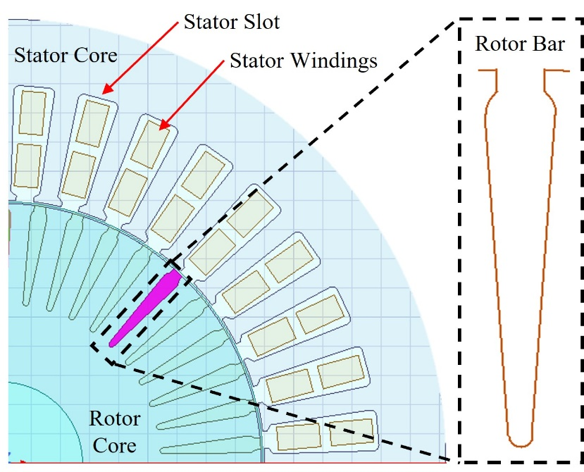
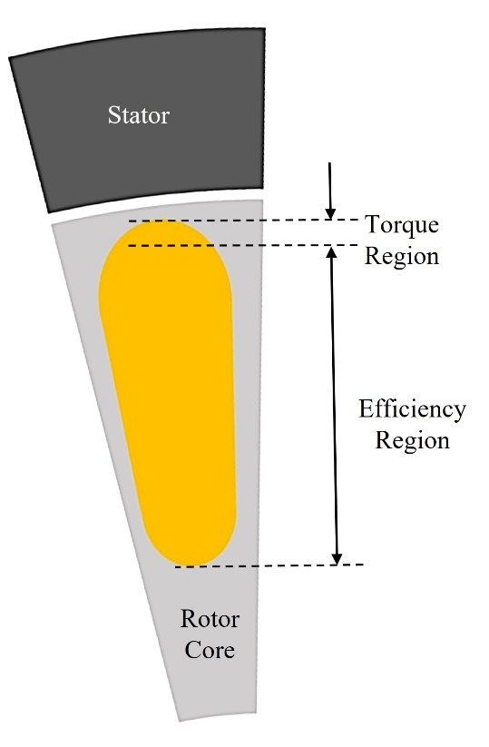
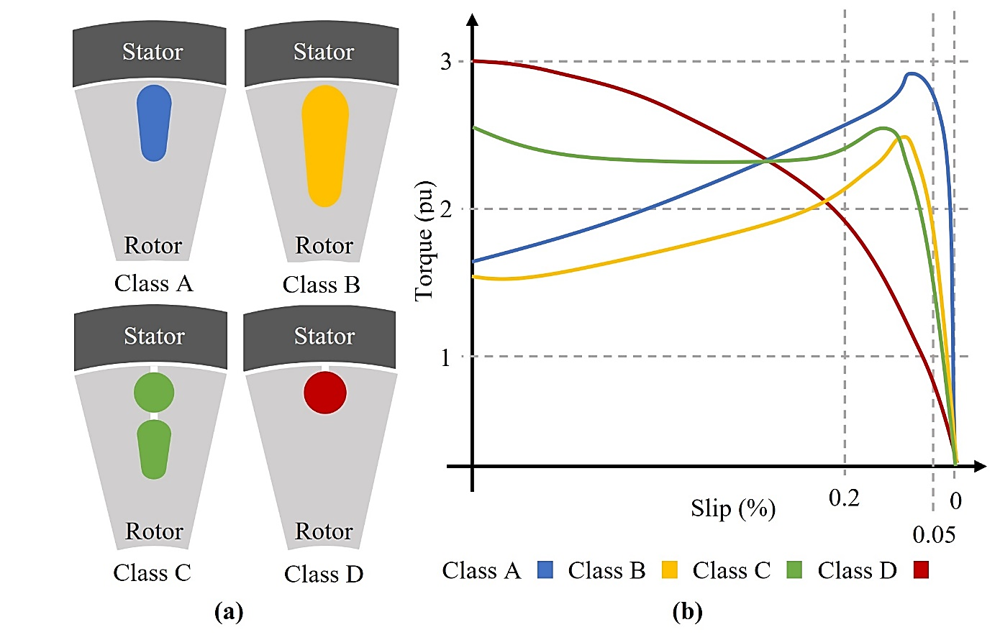
Tractive Induction Motor Structure
Fig. 4. Cross-sectional view of tractive IM structure and rotor bar is depicted
Fig. 5. Demonstrates rotor bar regions and affects on IM performance. [8]
Fig. 6. NEMA classifications assist in IM design. (a) Possible examples of NEMA class rotor bars are depicted. (b) Torque performance is plotted against slip for each rotor bar class. [9]
Rotor bar directly affects output torque and total losses therefore bar geometry selected as subject of optimization.
Notes:
IM Stator Structure and Design:
Stator slot geometry and winding configuration are crucial in field production
Stator structure and winding design of IMs are similar to PMSMs
IM Rotor Structure and Design:
Rotor structure is unique to IMs due to current carrying elements
Bar directly affects output torque and total losses, indirectly relating rotor bar to torque density and operating efficiency
Area near the top of the rotor bar known as torque region due to proximity to air gap
Lower portion of rotor bar is efficiency region due to the area of the rotor bar being related to rotor copper loss
NEMA class rotor bars demonstrate the effect of various rotor bar shapes on the IM torque performance

Slide 7
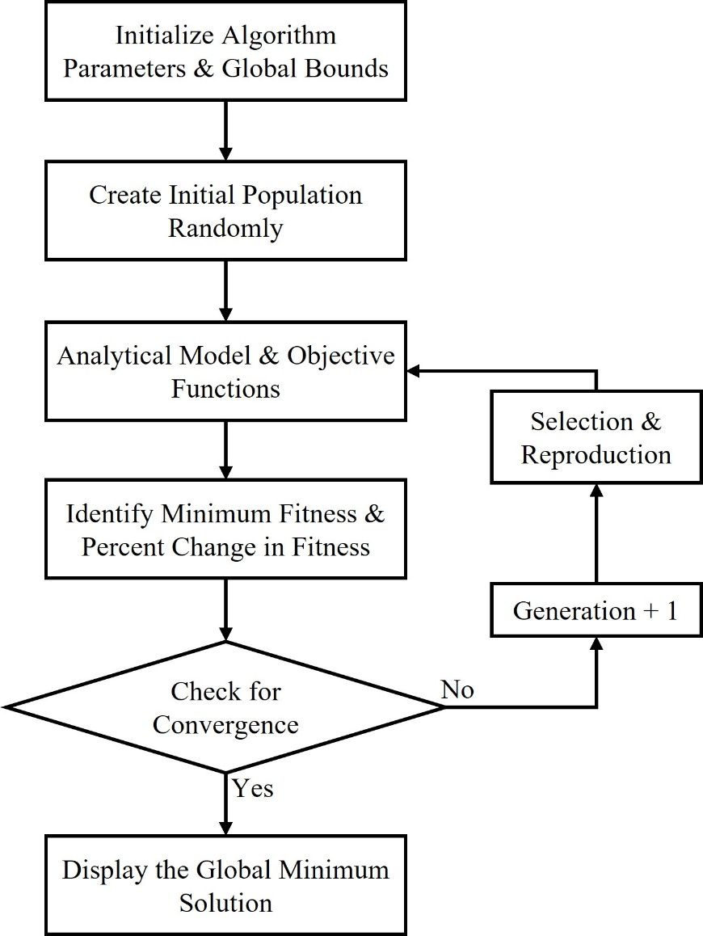
Optimization Algorithms
Common OAs for IM optimization:
Parametric Search (PS), Particle Swarm (PSO), Ant Colony (ACO) and Genetic Algorithms (GA)
Key performance parameters of OAs:
Rapid convergence, low run times and high solution quality
Robust structure against stalling and local solutions
Maintain large search spaces while being easily modified
OA must be selected ensuring rapid, high-quality solution over large search space while being easily modified for multiple objectives.
Fig. 7. Flow chart of conventional genetic algorithm variable flow. [10]
Notes:
What is Optimization?
Solve for global optimal solution of complex multivariable problems which may be assisted by optimization algorithms (OAs) ^{[5]}
Common OAs for IM optimization:
Parametric Search (PS), Particle Swarm (PSO), Ant Colony (ACO) and Genetic Algorithms (GA)
Key performance parameters of OAs:
Rapid convergence ensuring low run times and high solution quality
Robust structure against stalling and local solutions
Maintain large search spaces while being easily modified

Slide 8
Induction Motor Modeling for Optimization
Table 3. Advantages and Disadvantages of Analytical Models [11]–[15]
FEA |  | MEC |  | ECM
Advantage | Disadvantage | Advantage | Disadvantage | Advantage | Disadvantage
Extremely high accuracy simulation Models transient magnetic and electrical losses Multi-disciplinary effects may be considered | Extremely high run times, computationally heavy Search space, input variable, and objective limitations Not easily modified | Shorter run times Models magnetic leakage flux losses Easily modified to increase accuracy | Less accurate than FEA Electric losses effects not closely considered Requires modification to increase accuracy | Shorter run times Models electrical losses Easily modified to increase accuracy | Less accurate than FEA Electric loss effects are not closely considered Requires modification to increase accuracy
Modified ECM must be selected as analytical model due to low run times and accurate IM performance prediction.

Slide 9
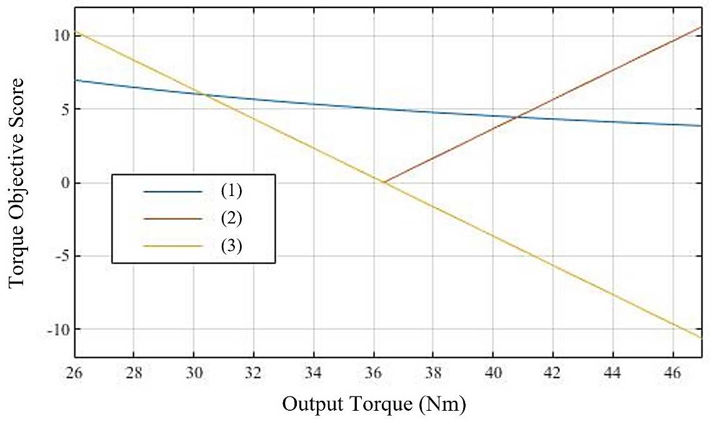
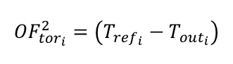
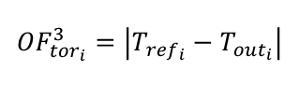
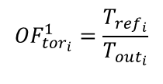
Objective Function Modeling and Bias
What is Objective Function Modeling and Function Bias?
Translator between the Analytical Model and the OA and are to be minimized ^{[16]}
Objective function (OF) bias causing stalling and un-optimal local solutions ^{[17]}
Drawbacks of Conventional OF Modeling:
Unbounded outputs lead to OF bias and dominated solutions ^{[18]}
Reference as lowest OF value is useful for tuning, not optimization
Negative integers increases complexity ^{[19]}
Sensitivity to performance improvements decays in exponential OFs
Tuning weights of OFs complex time-consuming process
$${OF}_{{tor}_{i}}^{1}=\frac{T_{{ref}_{i}}}{T_{{out}_{i}}}$$
(1)
$${OF}_{{tor}_{i}}^{3}=\left|T_{{ref}_{i}}−T_{{out}_{i}}\right|$$
(2)
$${OF}_{{tor}_{i}}^{2}=\left(T_{{ref}_{i}}−T_{{out}_{i}}\right)$$
(3)
Fig. 8. Three conventionally used OFs given by (1), (2) and (3) are evaluated over a 60% range of the base design. [20]–[22]
Conventional OF modeling causes Function bias decreasing solution quality and poor algorithm performance.
Notes:
What is Objective Function Modeling and Function Bias?
Translator between the Analytical Model and the OA and are to be minimized ^{[10]}
If objective function (OF) score of one objective dominates the other causing stalling, early convergence and un-optimal local solutions ^{[11]}
Drawbacks of Conventional OF Modeling:
Unbounded outputs cause differences in OF score magnitudes leading to OF bias and dominated solutions ^{[15]}
Reference as lowest OF value is useful for tuning, not optimization
Negative integers increases complexity and potential function bias ^{[16]}
Sensitivity to performance improvements decays in exponential OFs
Tuning weights of OFs complex time-consuming process

Slide 10
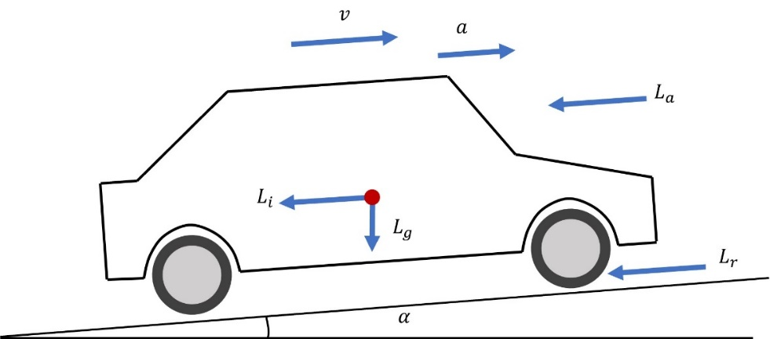
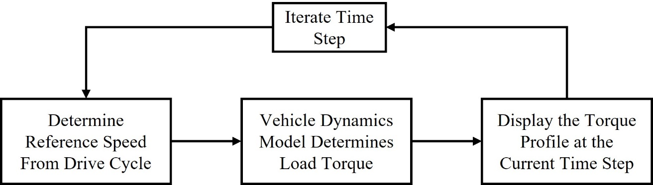
Considering Dynamic Operation Through Drive Cycle
Fig. 9. Iterative flow of drive cycle simulation to determine the torque profile with respect to the vehicle.
Fig. 10. Vehicle dynamics model used to determine the torque requirements of drive cycle. [23]
Dynamic load conditions of EV over various driving conditions (Highway, Rural and Urban)
Torque demand determined through Vehicle Dynamic Model
Complete operating range yields highest solution quality
Considering all operating points increases simulation time
Considering all operating points collected greatly increases solution quality however increases algorithm run time.
[17], [18]

Slide 11
Knowledge Gap & Novelty
Knowledge Gap
Conventional multi-objective function modeling introduces bias greatly effecting solution quality and run time.
Conventional IM optimization fails to consider dynamic operating range resulting in optimal design for single operating condition not representative of global optimal design
Conventional drive cycle reduction methods fail to consider optimization objectives during clustering resulting in poor representation of significant operating conditions.
Novelty
Robust, non-dominated multi-objective adaptive-restart GA considering ECG based dynamic tractive operation capable of high-quality optimization in low run times.
Tractive IM featuring optimized rotor bar geometry offering +3% torque and -3% losses resulting in +3% torque density and -1% efficiency for EV applications.

Slide 12
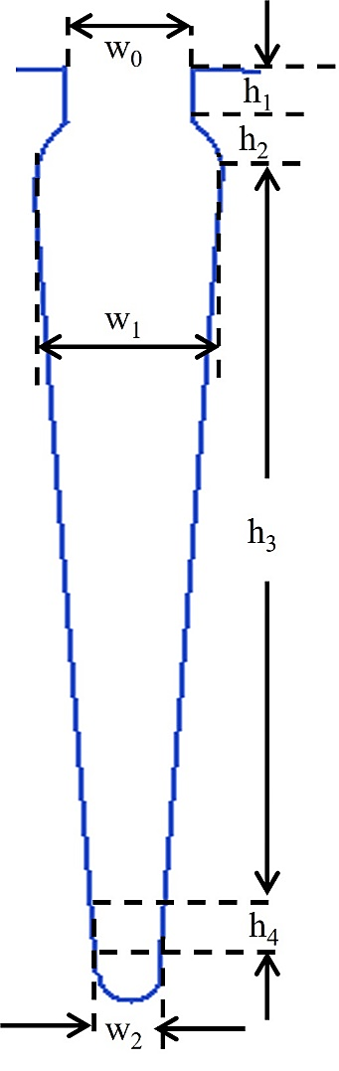
Input Variables and Optimization Objectives
Table 4. Optimization Input Variables and Objective Targets
Subject and Number of Input Variables | Seven input variables describe rotor bar geometry Four heights (h_{n}) and three widths (w_{n})
Input Variable Bounds | ±75% of baseline rotor bar design
Input Variable Constraints | Constrained by occupying a maximum of 70% of rotor slot pitch Minimum tooth width maintained
Design Constraints | Maximum flux density in rotor teeth may not exceed 1.7T
Performance Objective | Output torque and total losses selected as optimization objectives
Torque Objective Target | Increase output torque by 3%
Loss Objective Target | Decrease total losses by 3%
Fig. 11. Four heights and three widths represent the rotor bar as input variables to the OA.
Rotor bar represented by 7 input variables and optimized to maximize torque and minimize losses by 3%.

Slide 13
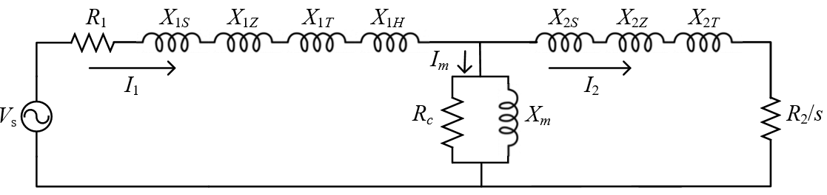
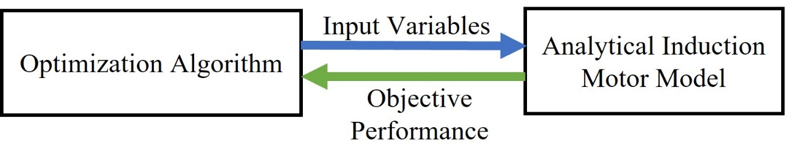
Permeance Based Equivalent Circuit Model
Benefits of Permeance based ECM:
Links bar geometry to torque and losses considering leakage effects and non-linearities.
Incorporation of effects and non-linearities improves model accuracy [P2]
Enhances sensitivity to changing geometry providing crucial feedback to algorithm.
Leakage Effects: Slot, zigzag and tooth-top leakage, overhang leakage in stator.
Non-Linearities: Skin, proximity, saturation and slotting effect.
Fig. 13. Simple flow chart demonstrates information flow between OA and analytical model of the tractive IM.
Fig. 12. Depicts the permeance based equivalent circuit model with non-linearities and leakage effects incorporated.
PECM selected as analytical model linking rotor bar geometry to output torque and total losses of tractive IM.
Notes:
PECM links rotor bar geometry to output torque and total losses considering leakage effects and non-linearities.
Incorporation of magnetic leakage effects and non-linearities greatly improves the accuracy of conventional ECM. [P2]
Enhances the model’s sensitivity to changes in rotor bar geometry crucial in providing feedback to algorithm.
Leakage Effects: Slot, zigzag and tooth-top leakage as well as overhang leakage in stator.
Non-Linearities: Skin, proximity, saturation and slotting effect.

Slide 14
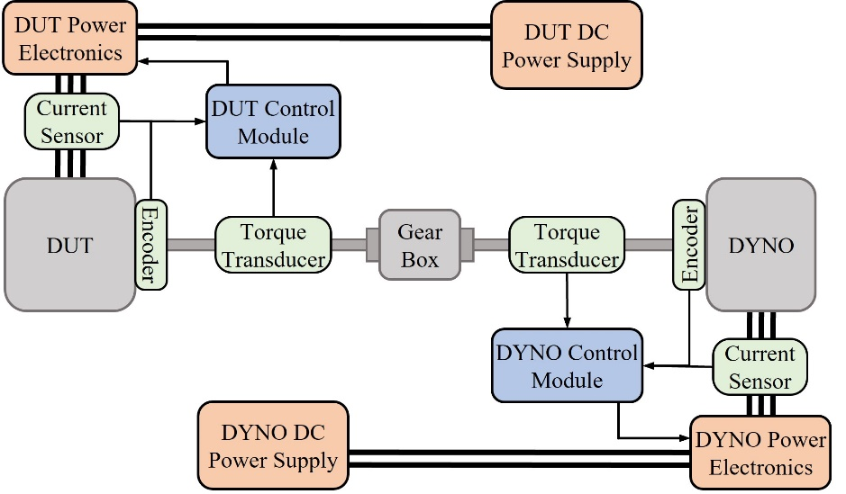
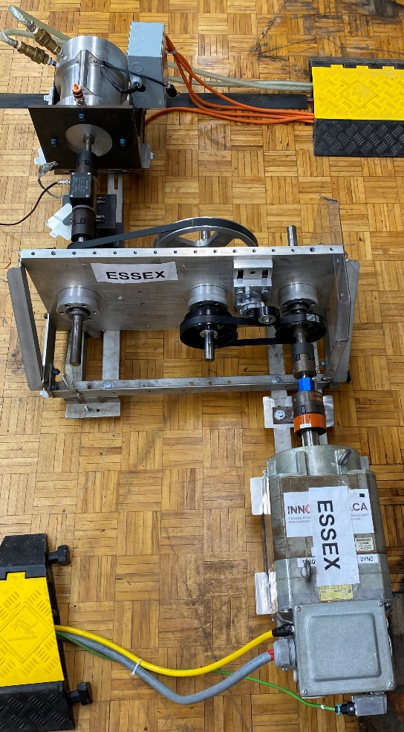
Permeance Based Equivalent Circuit Model Validation
Table 5. Baseline IM Parameters
Characteristic | Baseline
Rated DC Voltage | 396 V
Peak Line to Line Voltage | 227.9 V
Peak Input Current | 480 A
Output Power | 11 kW
Rated Torque | 36 Nm
Rated Speed | 3000 rpm
Fig. 14. Depicts experimental setup used to test 11 kW baseline IM at various operating points in constant torque and constant power region for model validation.
PECM accuracy validated against FEA simulation and experimental testing of 11kW Baseline IM at 5 operating points above and below base speed
PECM capable of torque, total loss and efficiency prediction within 5.2%, 6.8% and 1.8% of experimental results
Fig. 15. Depicts the 11kW baseline IM used in experimental validation.
PECM validated within an acceptable error against FEA and experimental results.
Notes:
Experimental Test Setup:
Low-speed/high-torque DYNO is used for experimental testing
Variable gear box offers wider operating range during testing
Limited to high-speed/low torque or low-speed/high-torque

Slide 15
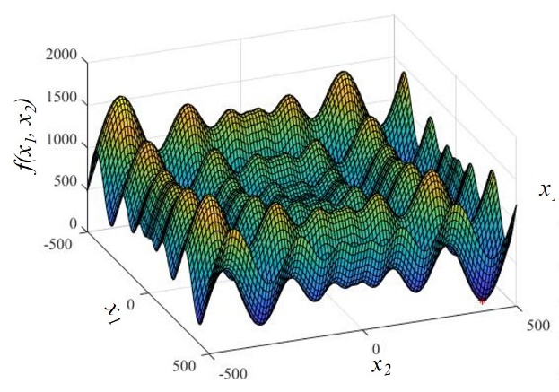
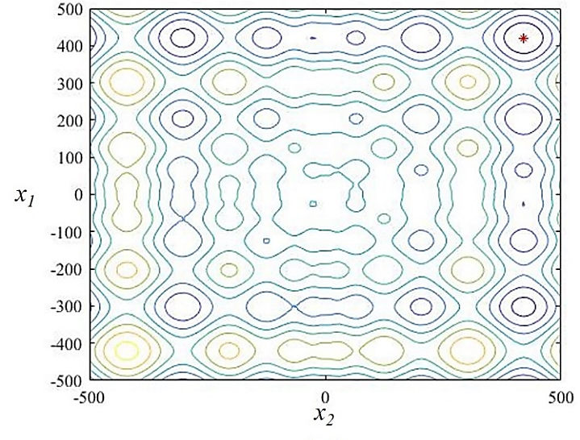
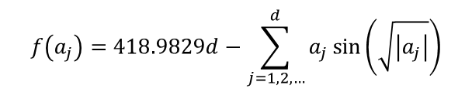
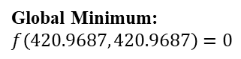
Optimization Algorithm Selection
$$f\left(a_{j}\right)=418.9829d−\sum_{j=1,2, …}^{d}{a_{j}\sin\left(\sqrt{\left|a_{j}\right|}\right)}$$
Schwefel Test Function:
(4)
Test functions gives even comparison with known minima for OA selection
Table 6. Optimization Algorithm Performance
Optimization Algorithm | PS | PSO | GA
Total Iterations | 13 | 52 | 39
Algorithm Run Time | 1.4560s | 9.3813s | 7.4137s
X1 Solution | 420.9706 | 420.9687 | 420.9687
X2 Solution | 420.9706 | 420.9687 | 420.9687
Function Value at Solution | 2.633x10⁻⁵ | 2.5455x10⁻⁵ | 2.5455x10⁻⁵
Error In Solution | 0.002633% | 0.002546% | 0.002546%
Global Minimum: $f\left(420.9687, 420.9687\right)=0$
Fig. 16. Depicts a surface and contour plot of the Schwefel Function and its global minima.
GA selected as OA for low run times, high solution quality and easy modification for multi-objective applications.
Notes:
Optimization test functions allows for even comparison between various OAs with known minima and optimal input variable vector for OA selection
PS, PSO and GA implemented to optimize Schwefel test function determining OA best suited for multi-objective rotor bar optimization.
PS optimization converged quickest however yielded the lowest solution quality.
Both PSO and GA offer high solution quality while maintaining a large search space.
GA performed 11 less iterations therefore converging 2 seconds faster than PSO which is magnified in more complex optimization problems.

Slide 16
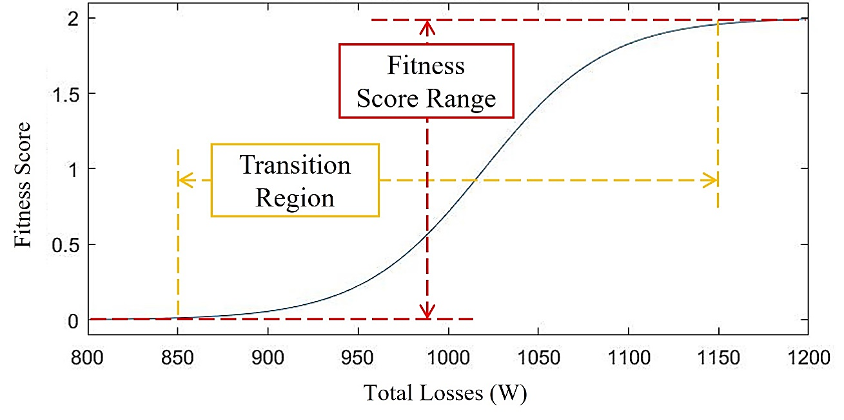
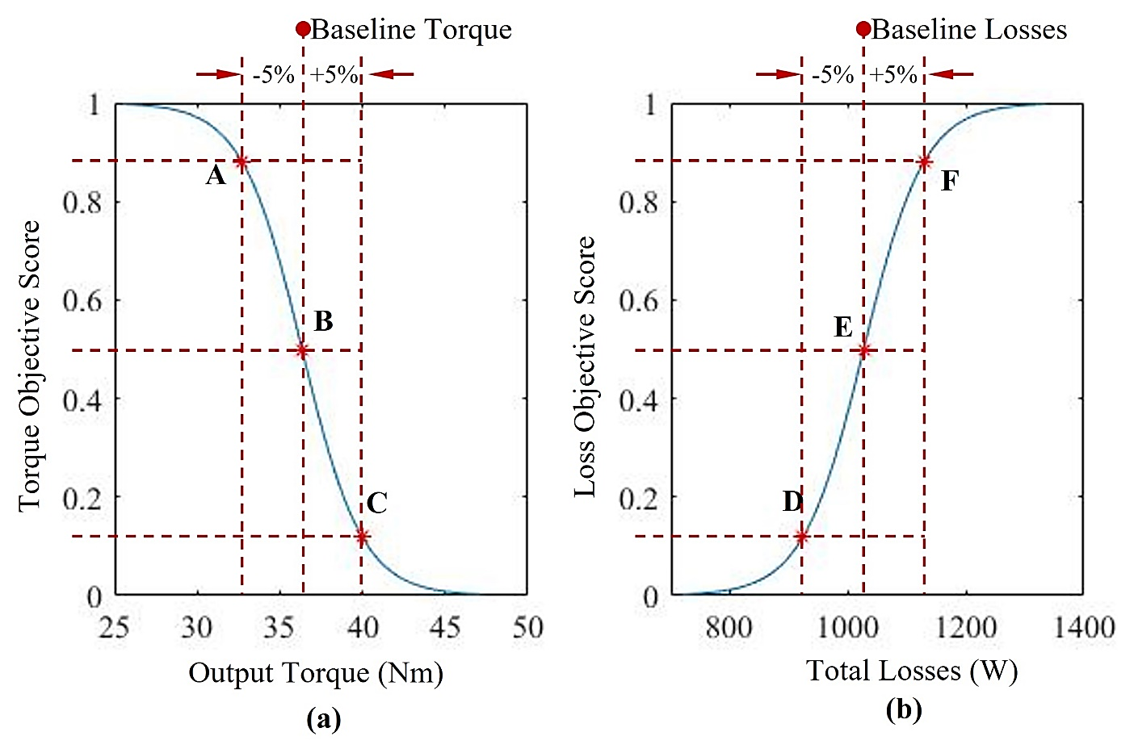
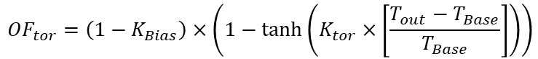
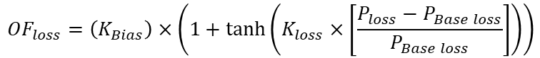
Novel Hyperbolic Tangent Based Objective Functions
Fig. 17. Novel hyperbolic tangent based OFs allow optimizer to easily tune fitness score range and transition region based on optimization problem.
$${OF}_{tor}=\left(1−K_{Bias}\right)×\left(1−\tanh\left(K_{tor}×\left[\frac{T_{out}−T_{Base}}{T_{Base}}\right]\right)\right)$$
(5)
$${OF}_{loss}=\left(K_{Bias}\right)×\left(1+\tanh\left(K_{loss}×\left[\frac{P_{loss}−P_{Base loss}}{P_{Base loss}}\right]\right)\right)$$
(6)
Fig. 18. Test points A to F have been placed to demonstrate resilience to function bias. (a) Depicts the hyperbolic tangent-based torque OF defined by (5). (b) Plots the hyperbolic tangent-based total loss OF defined by (6).
Novel hyperbolic tangent based OFs eliminate bias between multiple objectives ensuring global solution yields greatest overall improvement possible.
Notes:
Constrains any input to an equally bounded output
Output torque $T_{out}$and total losses $P_{loss}$fed from PECM
Bias factor $K_{Bias}$ allows designer to control and inject OF bias
Baseline performance $T_{Base}$ and $P_{Base loss}$set base point
Base point ensures equal and central OF score at the objective performance baseline IM
Scaling factors $K_{tor}$ and $K_{loss}$ tune the width of the transition region
Transition region is exponential for rapid convergence and determines sensitive to small change in fitness
Hyperbolic Tangent Based OFs allow Optimizer to easily tune algorithm sensitivity and precisely inject bias.

Slide 17
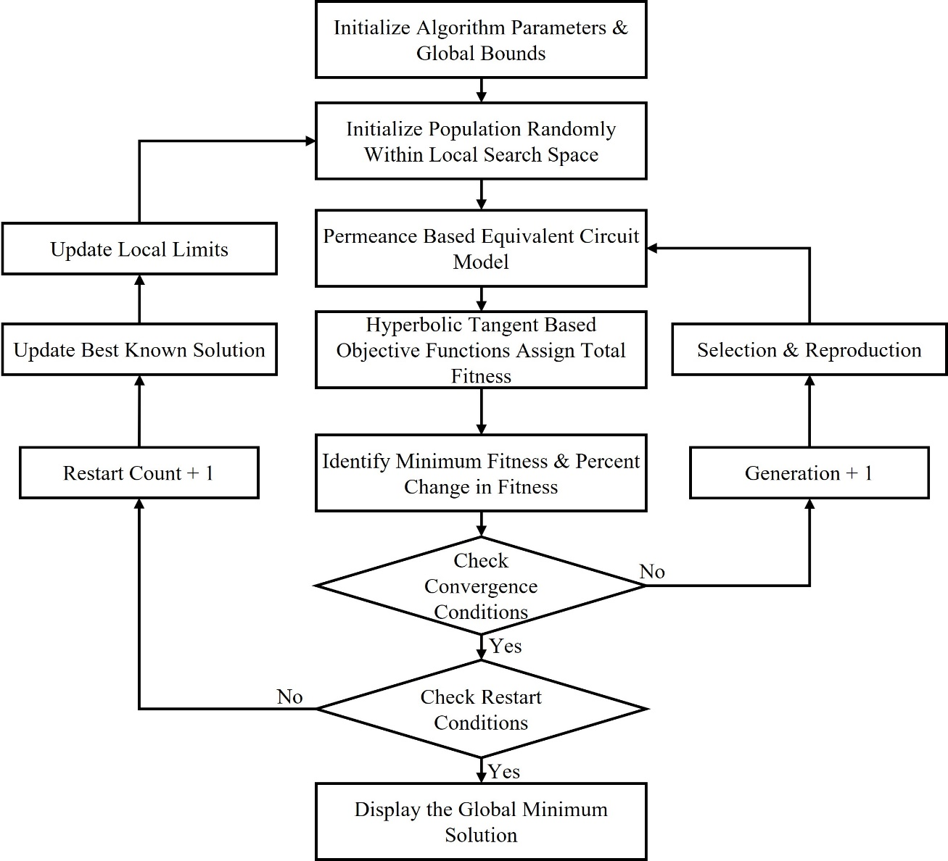
Modified Adaptive Restart Genetic Algorithm
Benefits of Adaptive Restart GAs
Enhances resistance to stalling and local solutions ^{[24]}
Reduced function tolerance without sacrificing solution quality
GA intelligently reduces search space around best-known solution ^{[25]}
Increases confidence in resulting global optimal solution
$${L_{ub}}_{j}\left(iter\right)=c_{j}\left(iter−1\right)+\left(1−K_{red}\right)×\left|{L_{ub}}_{j}\left(iter−1\right)−c_{j}\left(iter−1\right)\right|$$
(7)
$${L_{lb}}_{j}\left(iter\right)=c_{j}\left(iter−1\right)−\left(1−K_{red}\right)×\left|{L_{lb}}_{j}\left(iter−1\right)−c_{j}\left(iter−1\right)\right|$$
(8)
Adaptive Restart increases solution quality, resilience to stalling and local solutions and low OA run times.
Fig. 19. Flow chart of Adaptive Restart GA demonstrating nested iterative restart.
Notes:
Why Implement an adaptive restart?
To improve GAs resilience to stalling and converging to local solutions ^{[19]} maintaining low algorithm run times
Benefits of Adaptive Restart GAs
Centroid represents the best solution known to the algorithm
Restart criteria triggered if change in OF score falls below tolerance or the maximum stall generations is reached
If restart is triggered, best solution of previous run becomes centroid and bound are reduced through (11) and (12).
Enhances resistance to stalling and local solutions
Reduced function tolerance without sacrificing solution quality
GA intelligently reduces search space around best-known solution ^{[20]}
Increases confidence in resulting global optimal solution

Slide 18
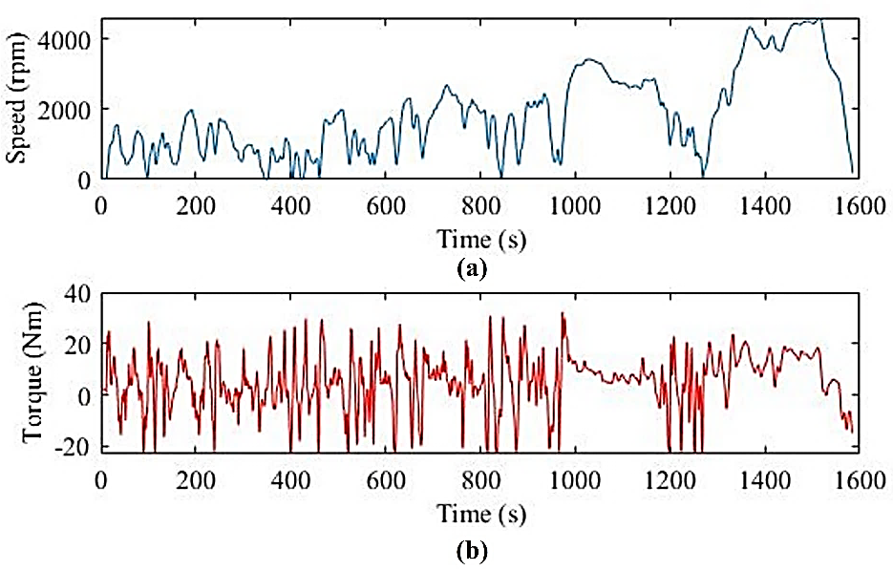
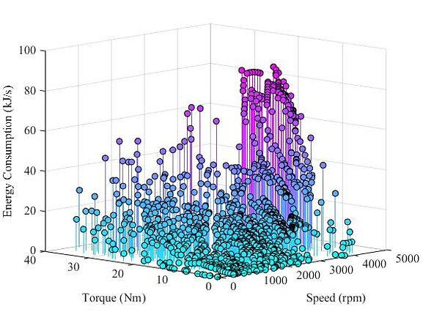
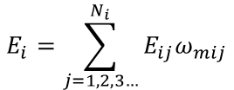
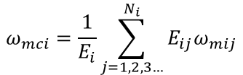
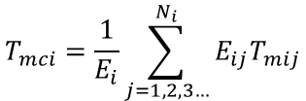
Drive Cycle Reduction using Energy Center of Gravity
Fig. 20. WLTC class 3 drive cycle selected for simulation. (a) Depicts speed profile of the simulated drive cycle. (b) Plots resultant load torque profile of the simulated drive cycle.
Fig. 21. The torque-speed profile generated over the WTLC drive cycle simulation and the associated energy consumption at each operating point.
$$T_{mci}=\frac{1}{E_{i}}\sum_{j=1,2,3…}^{N_{i}}{E_{ij}T_{mij}}$$
$$ω_{mci}=\frac{1}{E_{i}}\sum_{j=1,2,3…}^{N_{i}}{E_{ij}ω_{mij}}$$
$$E_{i}=\sum_{j=1,2,3…}^{N_{i}}{E_{ij}ω_{mij}}$$
(9)
(10)
(11)
ECG clustering greatly reduces run time while identifying most significant dynamic operating points with respect to energy consumption. ^{[26]}
Notes:
Why is operating point reduction required?
Operating points must be reduced to maintain low run times.
Most significant operating points may be determined based on energy consumption.
Energy Center of Gravity (ECG) Clustering:
Determines centroid location and magnitude based on normalized energy consumption of each sub-region.
Centroid torque ($T_{mci}$), speed ($ω_{mci}$) and total normalized energy ($E_{i}$) for each respective sub-region are calculated using (13), (14) and (15). ^{[21]}

Slide 19
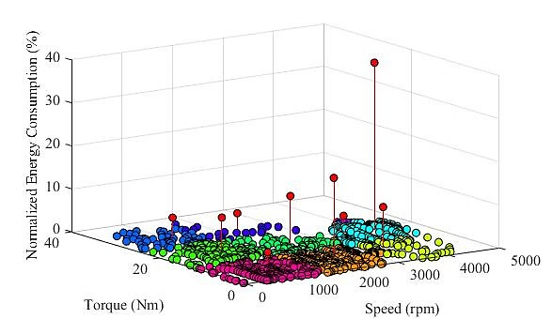
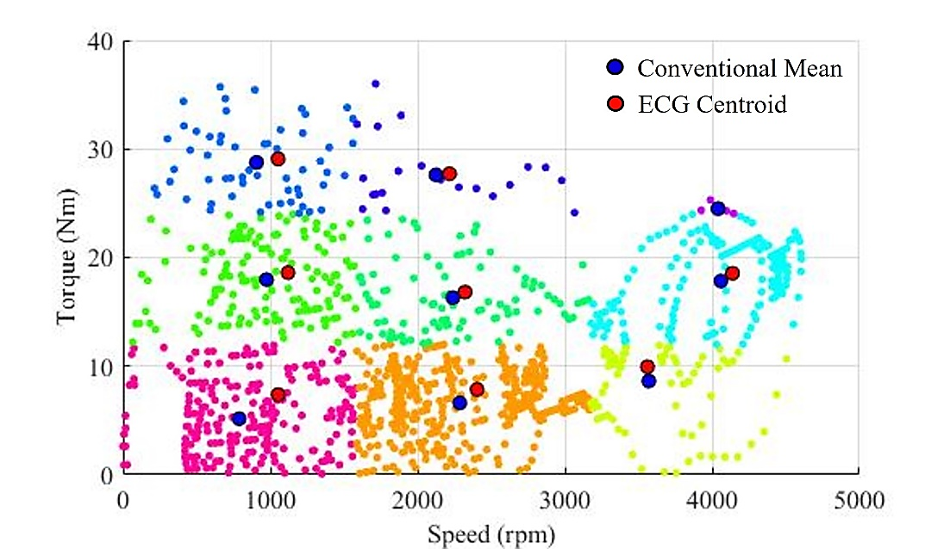
Energy Center of Gravity Clustering
Fig. 22. The centroid of each sub-region is highlighted in red among the measured operating points from the WLTC drive cycle test.
Fig. 23. The centroid position on the torque-speed sub-region with respect to conventional mean demonstrates the effect of energy center of gravity clustering.
ECG clustering ensured most significant operating points with respect to energy consumption are selected. ^{[27]}
Notes:
Torque-Speed operating points are grouped into equal sized sub-regions.
Each sub region is represented by the ECG centroid with a magnitude proportionate to energy consumption of sub-region.
Therefore, ECG centroid location differs from true conventional mean torque-speed average of each sub-region.

Slide 20
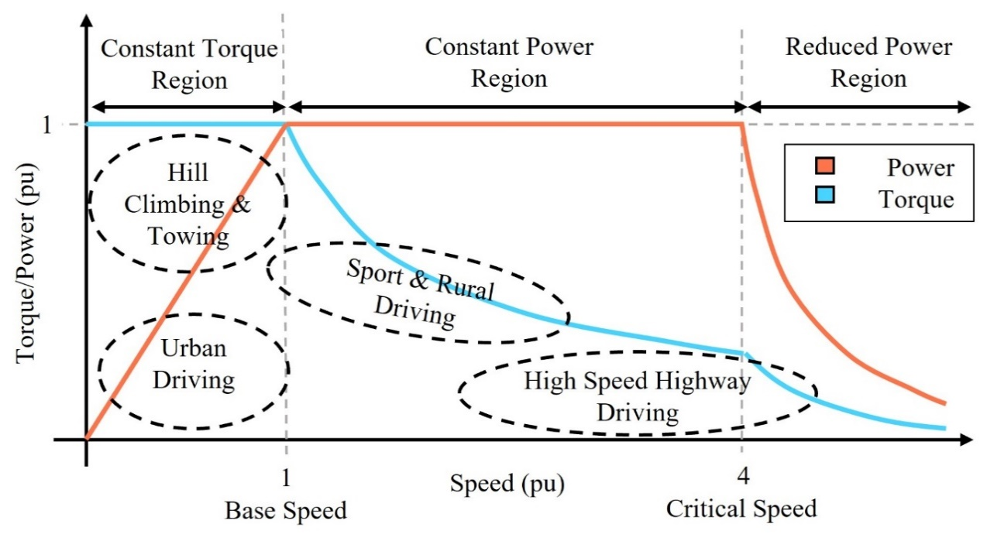
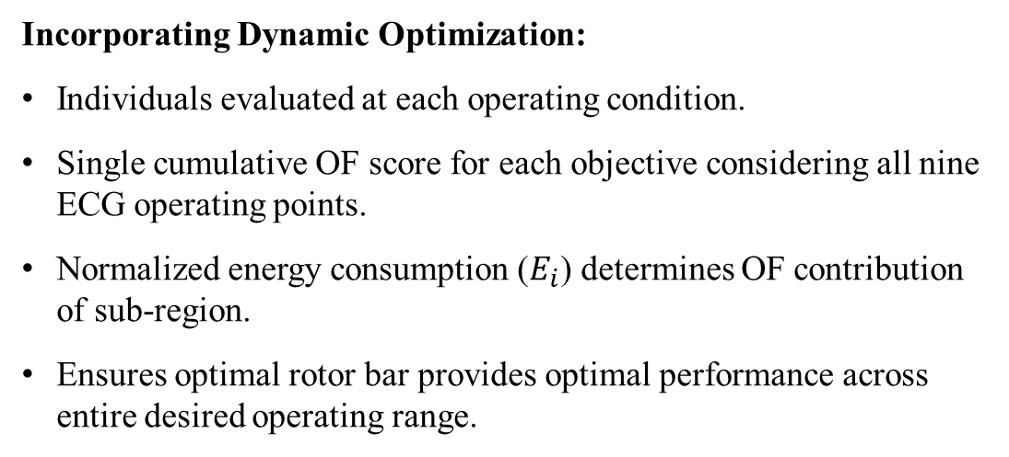
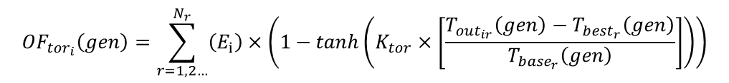
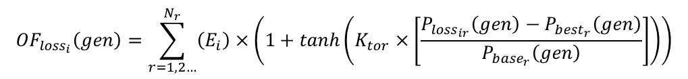
Optimization Considering Dynamic Operation
Incorporating Dynamic Optimization:
Individuals evaluated at each operating condition.
Single cumulative OF score for each objective considering all nine ECG operating points.
Normalized energy consumption ($E_{i}$) determines OF contribution of sub-region.
Ensures optimal rotor bar provides optimal performance across entire desired operating range.
Fig. 24. Depicts the desired torque and power performance required by different operating regions that appear in tractive applications.
$${OF}_{{tor}_{i}}\left(gen\right)=\sum_{r=1,2…}^{N_{r}}{\left(E_{i}\right)×\left(1−\tanh\left(K_{tor}×\left[\frac{T_{{out}_{ir}}\left(gen\right)−T_{{best}_{r}}\left(gen\right)}{T_{{base}_{r}}\left(gen\right)}\right]\right)\right)}$$
(12)
$${OF}_{{loss}_{i}}\left(gen\right)=\sum_{r=1,2…}^{N_{r}}{\left(E_{i}\right)×\left(1+\tanh\left(K_{tor}×\left[\frac{P_{{loss}_{ir}}\left(gen\right)−P_{{best}_{r}}\left(gen\right)}{P_{{base}_{r}}\left(gen\right)}\right]\right)\right)}$$
(13)
Greatly reduces run time while focusing GA on most significant dynamic operating points ^{[28]}
Notes:
Individuals produced by ARGA must be evaluated under each operating conditions determined by ECG.
Slight increase in run time is expected as a result.
A single cumulative OF score is assigned for each objective considering all operating points.
Normalized energy consumption ($E_{i}$) of determines objective contribution of each sub-region.
Ensures optimal rotor bar provides optimal performance across entire desired operating range.

Slide 21
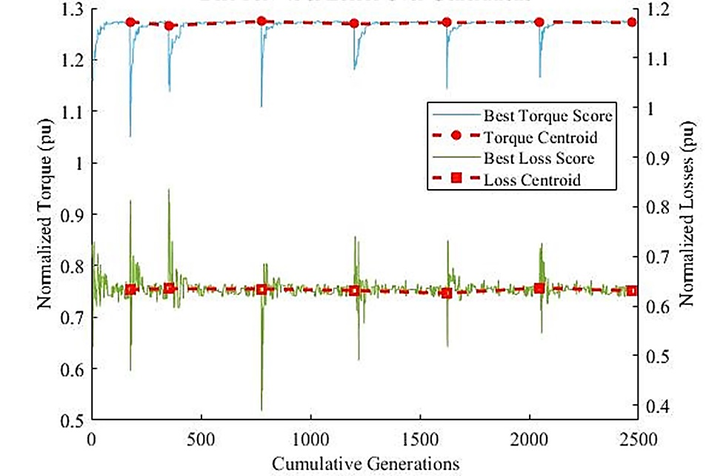
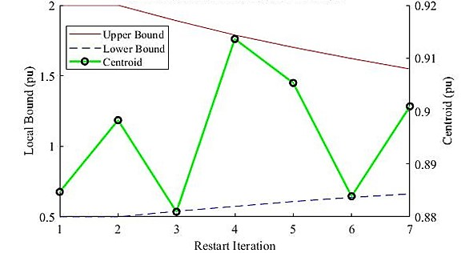
Adaptive Restart Genetic Algorithm Performance
Table 7.
Adaptive Restart Genetic Algorithm Performance
Performance | Value | Performance | Value
Total Number of Restarts | 7 | Centroid Output Torque OF Score | 0.279
Algorithm Run Time (s) | 98.91 | Centroid Total Loss OF Score | 0.483
Average Number of Generations | 357 | Total Centroid OF Score | 0.742
Maximum Number of Stall Generations | 32
Fig. 26. The local upper and lower bound with respect to one input variable and centroid evolution with respect to each restart iteration.
Fig. 25. Normalized torque and losses of the best-known solution at each generation across all restart iterations and the respective centroids.
ARGA performed 7 restarts, evaluating 357 generations each iteration, converged after 98.91 seconds
Search space successfully reduced maintaining low run times while increasing confidence and quality of solution.
ARGA successfully converged to high-quality non-dominated global optimal solution while maintaining low run times and resisting stalling and bias.
Notes:
ARGA performed 7 restart iterations evaluating an average 357 generations each iteration, converging after 98.91 seconds well below maximum run time.
Search space was successfully reduced each iteration maintaining low run times while restarts increase confidence and quality of global optimal solution.

Slide 22
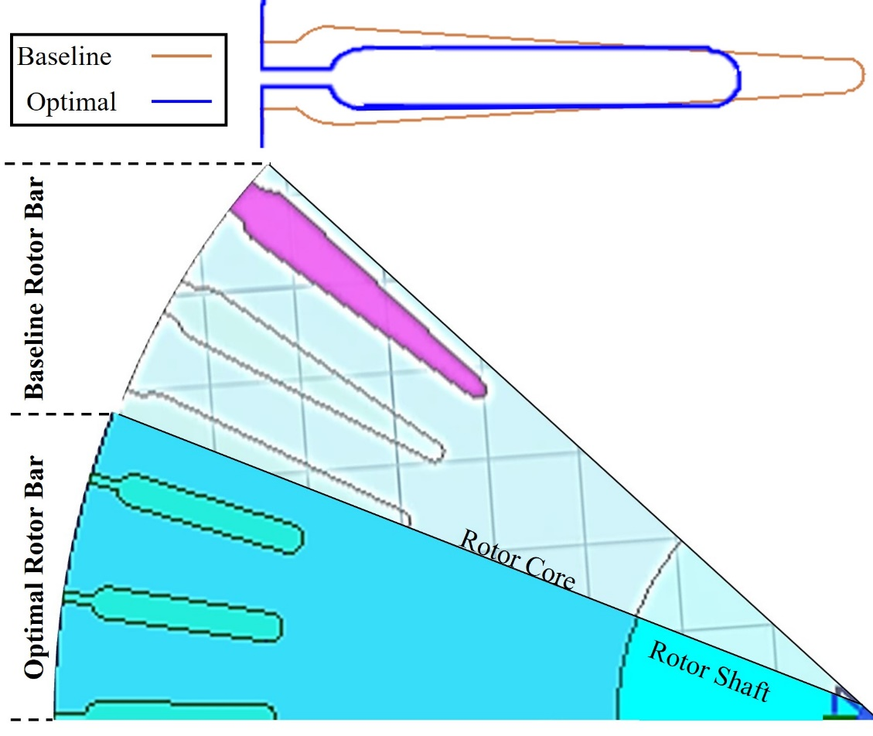
Optimal Rotor Bar Shape and Objective Performance
Table 8. Average Tractive Performance of Baseline and Optimal Rotor Bar
Performance Objective | Baseline IM | Optimized IM | Performance Improvement
Torque (Nm) | 21.24 | 22.77 | +7.51%
Losses (W) | 1,064.8 | 1,059.5 | -0.55%
Efficiency (%) | 79.05 | 80.19 | +1.30%
Fig. 27. Depicts an overlay of baseline rotor bar against the optimized rotor bar demonstrating the change in shape.
Fig. 28. Depicts the rotor structure of the baseline IM and the optimized IM proposed.
PECM is capable of torque, total loss and efficiency prediction of the baseline IM within 7.16%, 7.89% and 1.12% of FEA results, respectively.
Optimal IM offers +7.51% torque and -0.55% losses resulting in +7.51% torque density and +1.3% efficiency
Notes:
Torque region of rotor bar narrowed leading to increased torque output of optimal design
Efficiency region has narrowed and shallower reducing slot area
7.51% increase in output torque and 0.55% reduction in total losses
Optimal rotor bar design is validated against FEA simulation
5 operating points used for validation differ from operating conditions considered during optimization ensuring a global optimal design.
PECM is capable of torque, total loss and efficiency prediction of the baseline IM within 7.16%, 7.89% and 1.12% of FEA results, respectively.

Slide 23
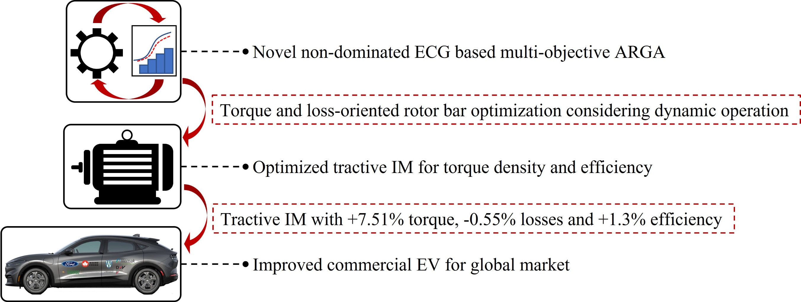
Concluding Statements
Novel method proposed satisfied global objective of developing and implementing multi-objective algorithm to optimize rotor bar geometry considering dynamic operation resulting in tractive IM improving commercial EVs.

Slide 24
Future Research Scope
Modify analytical model to incorporate rotor skewing and pitching
Incorporate meta-parameters as input variables (stack length, number of rotor bars, etc.)
Expand optimization to include stator slot geometry simultaneously
Incorporate thermal and vibrational effects ensuring multi-disciplinary optimal solution

Slide 25
Publication to Date
T. Stachl, Areej Fatima, Mohammad Sedigh Toulabi, Wenlong Li, Anthony Lombardi, Jimi Tjong, and Narayan C. Kar., “Torque and Loss Optimized Rotor Bar Design for an Induction Machine Using a Nondominated Genetic Algorithm Through Objective Function Modeling,” IECON 2021 – Accepted
A. Fatima, Areej Fatima, Tim Stachl, Mohammad Sedigh Toulabi, Wenlong Li, Jimi Tjong, Glenn Byczynski, and Narayan C. Kar, “Permeance–Based Equivalent Circuit Modeling of Induction Machines Considering Leakage Reactances and Non–Linearities for Steady–State Performance Prediction,” IECON 2021 – Accepted
Buddhika De Silva Guruwatta Vidanalage, Mohammad Sedigh Toulabi, Tim Stachl, Anthony Lombardi, Jimi Tjong, and Narayan C. Kar, “Winding Function-Based Analytical Modeling of Core Loss in an Induction Machine Considering Slotting Effects and the Frequency Dependent B-H Curve Characteristics” INTERMAG 2022 Digest – Accepted

Slide 26
Comments & Questions
Thank You
Any comments, feedback or questions?

Slide 27
References
[1] Electric Vehicle Database. [Online]. Available: https://ev-database.org/#sort:path~type~order=.rank~number~desc|range-slider-range:prev~next=0~1200|range-slider-acceleration:prev~next=2~23|range-slider-topspeed:prev~next=110~450|range-slider-battery:prev~next=10~200|range-slider-towweight:prev~next=0~2500|range-slider-fastcharge:prev~next=0~1500|paging:currentPage=0|paging:number=9
[2] EVSpecifications - Electric vehicle specifications, electric car news, EV comparisons. [Online]. Available: https://www.evspecifications.com
[3] Mark Kane. (2022, Feb). Compare Electric Cars: EV Range, Specs, Pricing & More. INSIDEEVs. [Online]. Available: https://insideevs.com/reviews/344001/compare-evs
[4] O. Dobzhanskyi, E. Amiri and R. Gouws, "Comparison analysis of electric motors with two degrees of mechanical freedom: PM synchronous motor vs induction motor," 2016 II International Young Scientists Forum on Applied Physics and Engineering (YSF), 2016, pp. 14-17, doi: 10.1109/YSF.2016.7753750.
[5] E. Gary, A. Magno and R. Jorge, “Design, analysis and validation of a six-phase induction machine from a commercial three-phase for academic research,” IEEE Latin America Transactions, vol. 18, no. 11, pp. 1943-1952, Nov. 2020. doi: 10.1109/TLA.2020.9398636.
[6] Audi MediaCenter (2017) Audi e-tron Sportback concept. [Online]. Available: https://www.audi-mediacenter.com/en/photos/detail/audi-e-tron-sportback-concept-44496
[7] J. Edmonson, D. Wyatt, and L. Gear, “Electric motors for Electric Vehicles 2022-2032,” IDTechEx, 23-Sep-2021. [Online]. Available: https://www.idtechex.com/en/research-report/electric-motors-for-electric-vehicles-2022-2032/842. [Accessed: 18-May-2022].
[8] M. Zeraoulia et al., “Electric motor drive selection issues for HEV propulsion systems: A comparative study,” IEEE Trans. Vehicular Technology, vol. 55, no. 6, pp. 1756–1764, Nov. 2006.
[9] D. Zhang et al., "A new optimal design method of rotor slot of three-phase squirrel cage induction motor for NEMA class D speed-torque characteristic using multi-objective optimization algorithm," IEEE Trans. Magnetics, vol. 48, pp. 879-882, Feb. 2012.
[10] A. Gupta et al., "Multi-objective design optimization of a three phase squirrel cage induction motor for electric propulsion system using genetic algorithm," in Proc. IEEE-STPEC, 2020.
[11] T. Schuhmann, B. Cebulski, and S. Paul, “Comparison of time-harmonic and transient finite element calculation of a squirrel cage induction machine for electric vehicles,” in Proc. Int. Conf. Electr. Mach., (ICEM), 2014, pp. 1037–1043. doi: 10.1109/ICELMACH.2014.6960309.
[12] D. K. Kim and B. il Kwon, “A novel equivalent circuit model of linear induction motor based on finite element analysis and its coupling with external circuits,” IEEE Trans. Magnetics, vol. 42, no. 10, pp. 3407–3409, 2006, doi: 10.1109/TMAG.2006.879078.
[13] L. Montier, T. Henneron, S. Clenet, and B. Goursaud, “Model Order Reduction Applied to a Linear Finite Element Model of a Squirrel Cage Induction Machine Based on POD Approach,” IEEE Trans. Magnetics, vol. 57, no. 6, pp.1-4, Jun. 2021. doi: 10.1109/TMAG.2021.3066678.
[14] T. A. Lipo, “Magnetic circuits,” Introduction to AC Machine Design, IEEE, 2018, pp. 1–50. doi: 10.1002/9781119352181.CH1.

Slide 28
References
[15] T. M. Wolbank, R. Woehrnschimmel, and H. Hauser, “Transient magnetic modeling and measurements of sensorless controlled induction machines,” IEEE Trans. Magnetics, vol. 38, no. 5, pp. 3279–3284, Sep. 2002. doi: 10.1109/TMAG.2002.803312.
[16] A. Marfoli et al., "Rotor design optimization of squirrel cage induction motor - Part I: Problem statement," IEEE Trans. Energy Conversion, vol. 36, pp. 1271-1279, 2021.
[17] S. Mallik et al., "Efficiency and cost optimized design of an induction motor using genetic algorithm," IEEE Transactions on Industrial Electronics, vol. 64, no. 12, pp. 9854-9863, Dec. 2017.
[18] E. Ghosh et al., "Temperature influenced online stator resistance estimation using an improved swarm intelligence technique for induction machine," IEEE Transportation Electrification Conference and Expo (ITEC), 2015.
[19] K. Hafiz et al., "Performance analysis of aluminum- and copper-rotor induction generators considering skin and thermal effects," in IEEE Transactions on Industrial Electronics, vol. 57, 2010.
[20] Y. Tai et al., "Efficiency optimization of induction motors using genetic algorithm and hybrid genetic algorithm," in Proc. ICEMS, 2011.
[21] M. di Nardo, A. Marfoli, M. Degano, C. Gerada, and W. Chen, “Rotor design optimization of squirrel cage induction motor-Part II: results discussion,” IEEE Trans. Energy Conversion, vol. 36, no. 2, pp. 1280–1288, Jun. 2021. doi: 10.1109/TEC.2020.3020263.
[22] M. Etemadi et al., "Design optimization of wound rotor induction motor using genetic algorithm," 5th Conference on Knowledge Based Engineering and Innovation, 2019, pp. 827-832.
[23] F. Gao, Q. Hu, J. Ma, and X. Han, “A simplified vehicle dynamics model for motion planner designed by nonlinear model predictive control,” Applied Sciences, vol. 11, no. 21, Nov. 2021. doi: 10.3390/app11219887.
[24] J. Hughes, et al., "Recentering, reanchoring & restarting an evolutionary algorithm," 2013 World Congress on Nature and Biologically Inspired Computing, 2013.
[25] L. A. Pereira et al., "Multiobjective optimization of five-phase induction machines based on NSGA-II," IEEE Transactions on Industrial Electronics, vol. 64, no. 12, pp. 9844-9853, Dec. 2017.
[26] Z. Lou, "An Intelligent Teaching Test Paper Generation System Based on Ant Colony Hybrid Genetic Algorithms," 2021 13th International Conference on Measuring Technology and Mechatronics Automation (ICMTMA), 2021.
[27] S. Sridharan and P. T. Krein, "Induction motor drive design for traction application based on drive-cycle energy minimization," 2014 IEEE Applied Power Electronics Conference and Exposition - APEC 2014, 2014.
[28] P. Korta, et al., "A novel hybrid approach towards drive-cycle based design and optimization of a fractional slot concentrated winding SPMSM for BEVs," 2017 IEEE Energy Conversion Congress and Exposition (ECCE), 2017

